Slide 1

ECE 2700
Digital Circuits
Logic Simplifications
Copyright © 2010 Frank Vahid
Instructors of courses requiring Vahid's Digital Design textbook (published by John Wiley and Sons) have permission to modify and use these slides for customary course-related activities, subject to keeping this copyright notice in place and unmodified. These slides may be posted as unanimated pdf versions on publicly-accessible course websites.. PowerPoint source (or pdf with animations) may not be posted to publicly-accessible websites, but may be posted for students on internal protected sites or distributed directly to students by other electronic means. Instructors may make printouts of the slides available to students for a reasonable photocopying charge, without incurring royalties. Any other use requires explicit permission. Instructors may obtain PowerPoint source or obtain special use permissions from Wiley – see http://www.ddvahid.com for information.

Slide 2
Today’s Objectives
To deepen your understanding on how to use Boolean Algebra to simplify/convert/manipulate digital circuits
To understand the difference between optimization and tradeoff

Slide 3
Representations of Boolean Functions
English 1: F outputs 1 when a is 0 and b is 0, or when a is 0 and b is 1.
Only one truth table for any given Boolean function
English 2: F outputs 1 when a is 0, regardless of b’s value.
a
a
b
F
b
0
0
1
Equation 1: F(a,b) = a’b’ + a’b
F
0
1
1
Equation 2: F(a,b) = a’
1
0
0
Circuit 1
1
1
0
Truth table
a
F
Circuit 2
T
he function F

Slide 4
Truth Table Representations
Can be tedious as number of variables exceeds 5
a
b
F
a
b
c
F
a
b
c
d
F
0
0
0
0
0
0
0
0
0
0
1
0
0
1
0
0
0
1
1
0
0
1
0
0
0
1
0
1
1
0
1
1
0
0
1
1
1
0
0
0
1
0
0
1
0
1
0
1
0
1
1
1
0
0
1
1
0
1
1
1
0
1
1
1
1
0
0
0
1
0
0
1
1
0
1
0
1
0
1
1
1
1
0
0
1
1
0
1
1
1
1
0
1
1
1
1

Slide 5
Question (AP)
Using truth tables, are F and G equivalent?
  F = xy + xy’ + y’z
  G = yz + x’z’
  Yes
  No
  ☹

Slide 6
Converting among Representations
Equation
OR each input term
that outputs 1
Last week
    Evaluate for each input combination, possibly
    creating intermediate columns
Circuit
Truth Table

Slide 7
Circuit to Truth Table
First convert to circuit to equation, then equation to table
a
a + b
(a + b)'
b
F
c
(a + b)’c
Inputs
Outputs
a
b
c
a + b
(a + b)'
F
0
0
0
0
1
0
0
0
1
0
1
1
0
1
0
1
0
0
0
1
1
1
0
0
1
0
0
1
0
0
1
0
1
1
0
0
1
1
0
1
0
0
1
1
1
1
0
0

Slide 8
Multiple-Output Circuits
Can give each a separate circuit, or can share gates
Example: F = a + bc, G = ab + bc
a
a
b
b
c
F
c
F
G
G

Slide 9
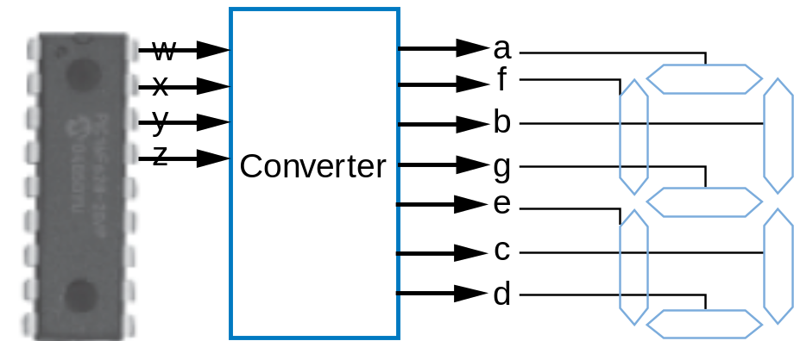
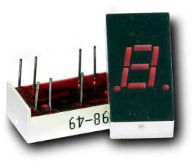
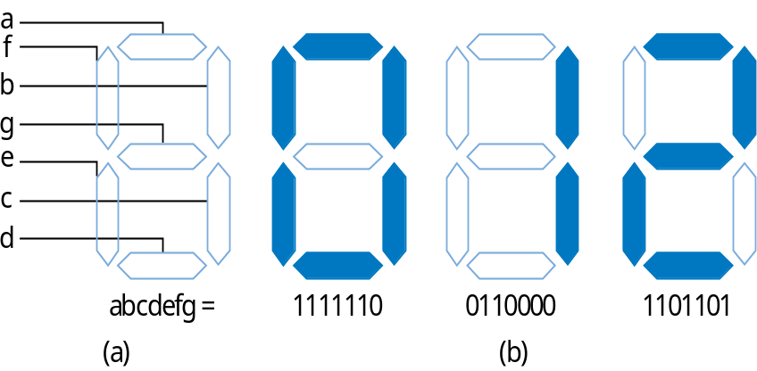
Multiple-Output Example

Slide 10
Boolean Equations in Canonical Form
(Standard form)
Regular algebra: how do you know if the following equations are equivalent?
  F = 5x² + 4x + 4
  G = 3x² + 4x + 2x² + 3 + 1
Boolean algebra: create sum of minterms
  Minterm: product term with every literal appearing exactly once, in true or complemented form

Slide 11
Minterms for Three Variables
Mystery Function
x | y | z | F | Minterm
0 | 0 | 0 | 1 | x’y’z’
0 | 0 | 1 | 0 | x’y’z
0 | 1 | 0 | 0 | x’yz’
0 | 1 | 1 | 1 | x’yz
1 | 0 | 0 | 1 | xy’z’
1 | 0 | 1 | 0 | xy’z
1 | 1 | 0 | 1 | xyz’
1 | 1 | 1 | 0 | xyz
F = x’y’z’ + x’yz + xy’z’ + xyz’
  F is in canonical form (sum of minterms)

Slide 12
Writing a Boolean Eqn. in Canonical Form
Steps
  Obtain sum of product terms by multiplying-out equation
  Expand each term until all terms are minterms
Can be handy when you need to compare two equations

Slide 13
Building Better Circuits
Two important design criteria
  Delay – the time from inputs changing to new correct stable output
  Size – the number of transistors
  Ideally, we want a small circuit with a small delay
For quick estimation, assume
  Every gate has a delay of “1 gate-delay”
    AND, OR, NOT gates
  Every gate input requires 2 transistors
    Only AND and OR gates
    Ignore NOT gates

Slide 14
Optimization
F = (x + y) z + y’z
G = z
16 transistors
x
3 gate-delays
y
z
G
z
0 transistors
F
No gate-delay (only wire delay)
y
z
20
F
Transforming F to G represents an optimization: Better in all criteria of interest
15
size
(transistors)
10
5
G
1
2
3
4
delay (gate-delays)

Slide 15
Tradeoff
F = a + bc + cd
G = a + c (b + d)
a
a
14 transistors
b
2 gate-delays
G
c
F
c
c
b
12 transistors
d
d
3 gate-delays
20
Transforming F to G represents an tradeoff: Some criteria better, others worse
15
F
size
(transistors)
G
10
5
1
2
3
4
delay (gate-delays)

Slide 16
Question (AP)
How many transistors does the following circuit have?
  F = xy + x’y’ + w
  10
  12
  14
  16
  ☹

Slide 17
Question (AP)
What is the number of gate delays for the following circuit assuming each gate has 2 inputs?
  F = xy + x’y’ + w
  0
  1
  2
  3
  4

Slide 18
Optimization vs. Tradeoff
Tradeoffs
We obviously prefer optimizations, but often must accept tradeoffs
  You can’t build a car that is the most comfortable, and has the best fuel efficiency, and is the fastest – you have to give up something to gain other things
Optimizations
Some criteria of interest are improved, while others are worsened
All criteria of interest
are improved (or at least kept the same)
size
size
del
a
y
del
a
y

Slide 19
How To Determine Which Options Is Better?
Usually specified by your client, boss, etc…
14 transistors
12 transistors
w
2 gate-delays
w
3 gate-delays
x
x
G1
y
G2
w
z
y
z
G1 = wx + wy + z
G2 = w(x+y) + z

Slide 20
Other Design Criteria
Power
Temperature
Many others…

Slide 21




Temperature Concern
Sun’s Surface
10000
Rocket Nozzle
1000
Nuclear Reactor
100
Power Density (W/cm²)
Hot Plate
10
8086
P6
8008
8085
386
Pentium® proc
4004
286
486
8080
Year
1
1970
1980
1990
2000
2010

Slide 22
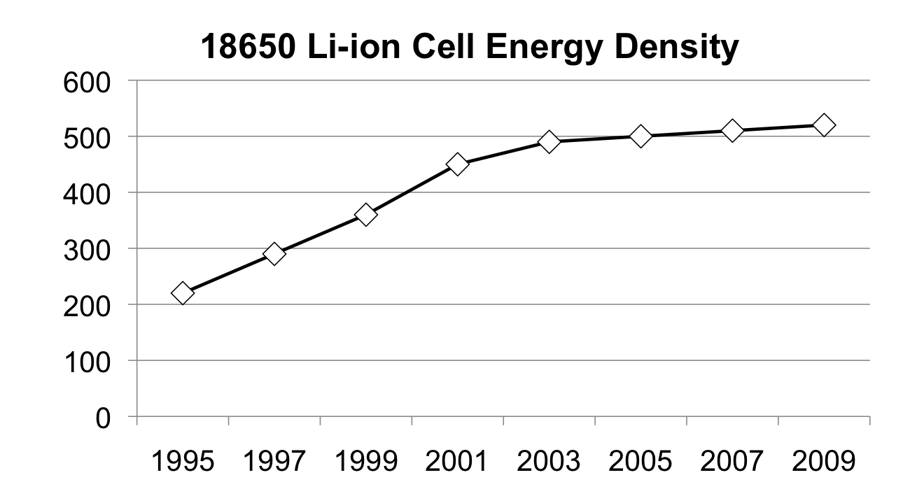
Battery Capacity
Energy Density (Wh/L)
Year

Slide 23
Our Focus
Two-level size optimization using algebraic methods
  Two-level circuit (ORed AND gates) with fewest transistors
  Though transistors getting cheaper (Moore’s Law), still cost something
Remember sum-of-products?
  F = abc + abc’ is sum-of-products
  G = w(xy + z) is not
Transform sum-of-products equation to have fewest literals and terms

Slide 24
Algebraic Two-Level Size Optimization (1)
Multiply out to sum-of-products, then…
Apply the following as much as possible
  ab + ab’ = a(b + b’) = a*1 = a
    Combining terms to eliminate a variable
    (Formally called the “Uniting theorem”)
Sometimes after combining terms, can combine resulting terms
F = ab’c’ + ab’c + abc’ + abc
F = ab’(c’ + c) + ab(c’ + c)
F = ab’*1 + ab*1
F = ab’ + ab
F = a(b’ + b)
F = a*1
F = a

Slide 25
Algebraic Two-Level Size Optimization (2)
Duplicating a term sometimes helps
  Doesn’t change function
  c + d = c + d + d = c + d + d + d + d ...
F = ab’c’ + ab’c + abc’ + abc + a’bc
F = ab’c’ + ab’c + abc’ + abc + a’bc + abc
F = ab’(c’ + c) + ab(c’ + c) + (a’ + a)bc
F = ab’*1 + ab*1 + 1*bc
F = ab’ + ab + bc
F = a(b’ + b) + bc
F = a*1 + bc
F = a + bc

Slide 26
Algebraic Two-Level Size Optimization (3)
Sometimes, it may be hard to see opportunities to simplify equations
  There are no hard and fast rules on how to simplify an expression
  Can we guarantee success?
Use a pictorial form of truth table!

Slide 27
Today’s Objectives
To deepen your understanding on how to use Boolean Algebra to simplify/convert/manipulate digital circuits
To understand the difference between optimization and tradeoff

Slide 28
Question
What’s the canonical form of the following Boolean equation?
  F = abc + bc

